Slide 1
Verification

Slide 2
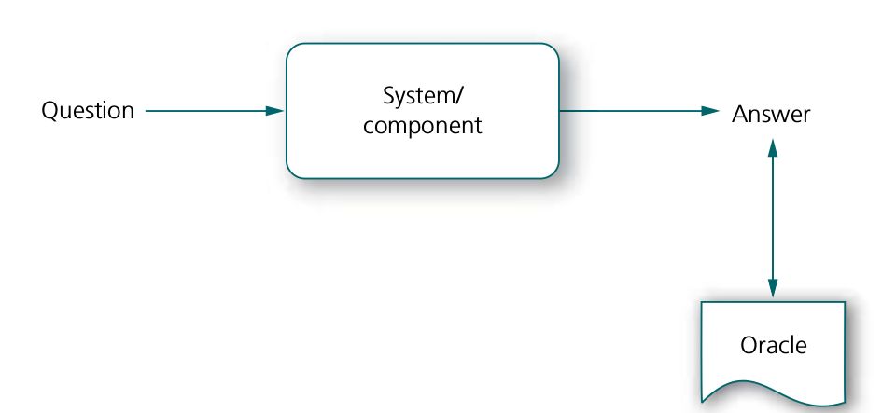

Slide 3
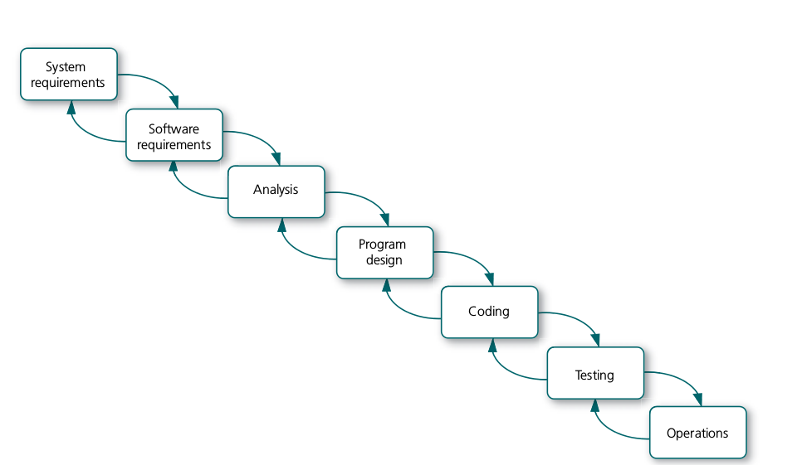
Effects of Testing - Waterfall Model

Slide 4
The waterfall model is a sequential (non-iterative) design process, used in software development processes, in which progress is seen as flowing steadily downwards (like a waterfall) through the phases of conception, initiation, analysis, design, construction, testing, production/implementation and maintenance.
The waterfall Model illustrates the software development process in a linear sequential flow.

Slide 5
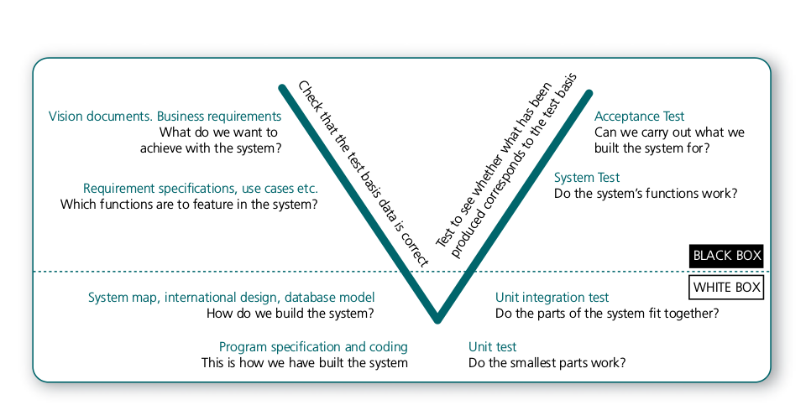
Effects of Testing - V Model

Slide 6
The V - model is SDLC model where execution of processes happens in a sequential manner in V-shape. It is also known as Verification and Validation model. V - Model is an extension of the waterfall model and is based on association of a testing phase for each corresponding development stage.
V model relates test basis and testing
In the figure, test basis (the information that the tests are based on) is in the left side and test activity is in the right side.
A test designer should involve at the early stage to check the Quality of the test basis documents especially requirements documents.

Slide 7
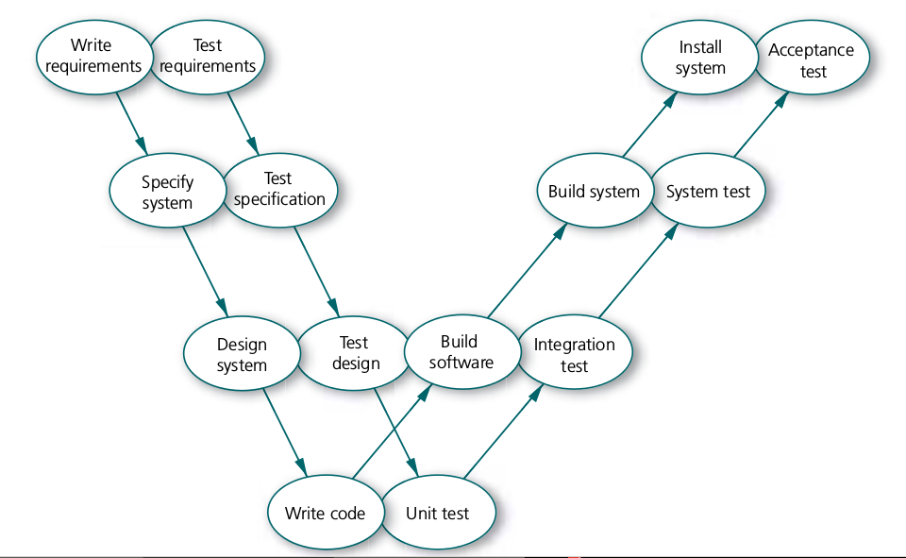
Effects of Testing - W Model

Slide 8
V model only shows dynamic test cycles, but W models gives a broader view of testing
The connection between the various test stages and the basis for the test is clear with W Model
Introduced by Paul Herzlich in 1993.
In this Model, every activity in the chain of development, there is a corresponding test activity.
Every development activity has a corresponding test activity. The aim of the test activities is to determine whether the delivered product fulfill its requirements.

Slide 9
Effects of Testing - Unified Process
Each phase containing one or more iterations and delivers something which is totally complete
Includes-
Inception - why this new system is needed.
Elaboration- focuses on architecture.
Construction - where the system is developed
Transition - Deliver the product to customer with quality.

Slide 10
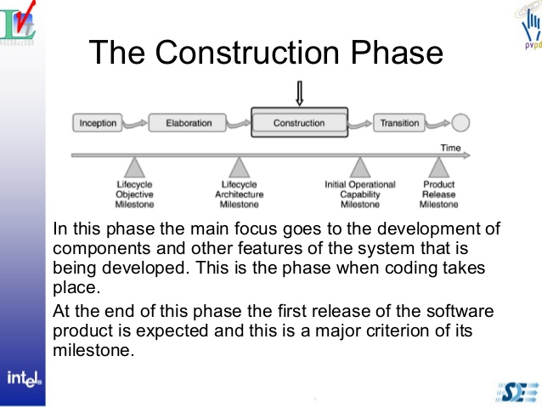

Slide 11
Inception - No execution of test cases but Verication will be done.
Elaboration - Testing on architecture
Construction- has more of the classic type of test work
Transition-acceptance testing does occur.

Slide 12
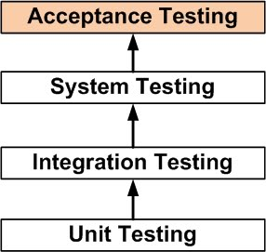

Slide 13
Disadvantage –regression testing is not possible in unified process

